Slide 1

HoloTrip
Explore. Work. Play. Together.
Project by Aaron Meaney and Wagner de Oliveira

Slide 2


What is HoloTrip?
Launch Day App!
Explore.
Work.
Play.
Together.

Slide 3

How does HoloTrip Work?
HPU
GPU
HoloLens
CPU
Data Synch
Client
Display
Objects
Record Objects
Host

Slide 4

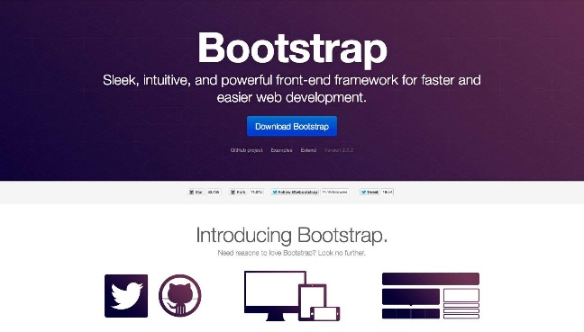



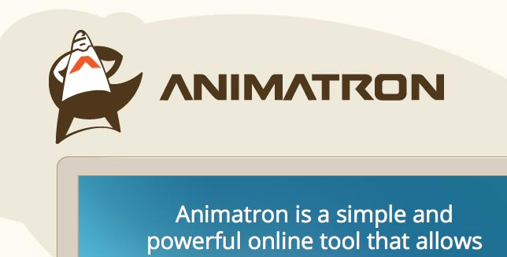



Campaign Overview

Slide 5
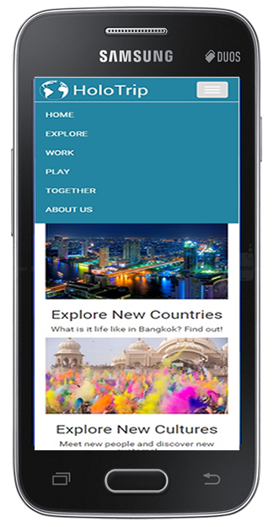

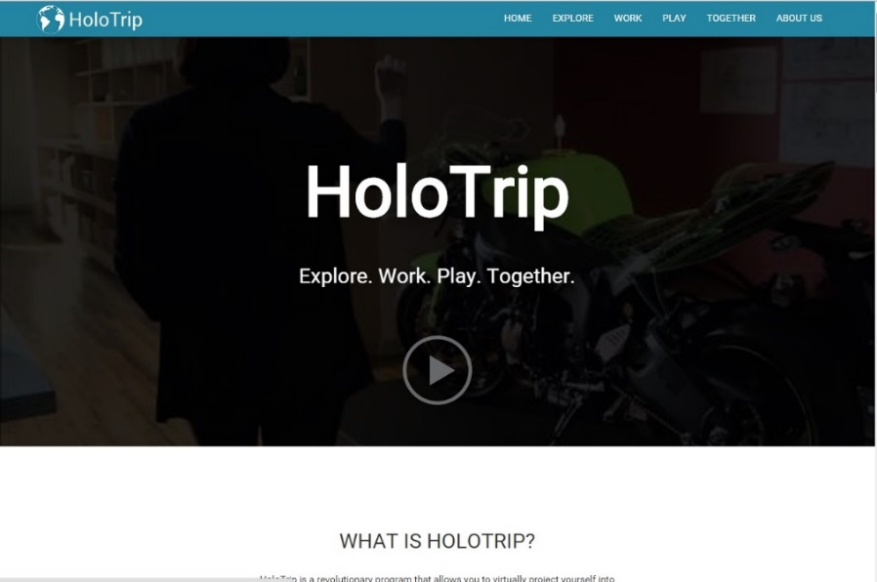
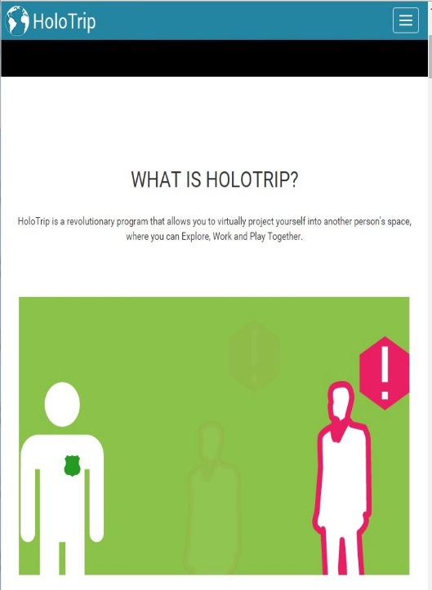
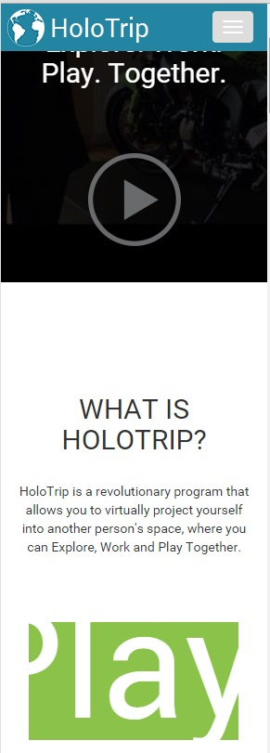

Responsive Website

Slide 6
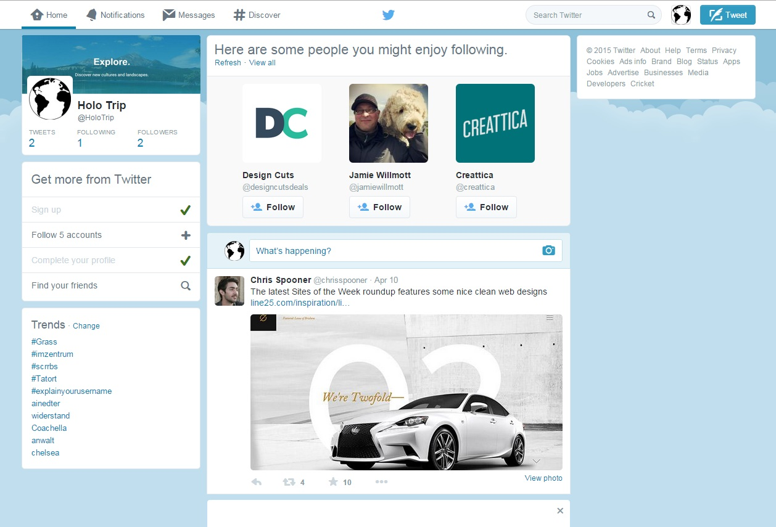
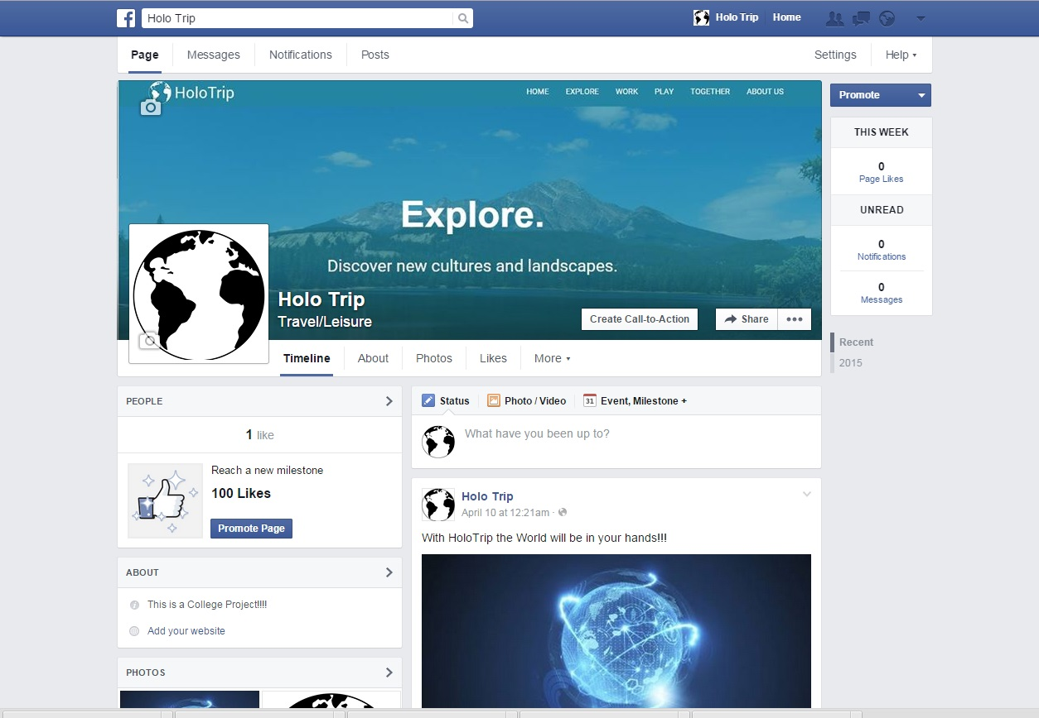

Social Media Presence

Slide 7


The Future of HoloTrip
HoloTrip +
Collaborate Anywhere
HoloHub™
GitHub
Remote

Slide 8
HoloTrip
Explore. Work. Play. Together.
Thank you for your attention!
Project by Aaron Meaney and Wagner de Oliveira

